Slide 1
RATINGS PREDICTION

Slide 2
PROBLEM STATEMENT AND UNDERSTANDING

Slide 3
For this project, we want to predict the ratings. Our client has a website for reviewing technical products. They are decide to add ratings to the product in the website. Ratings related to review. We want to collect the data of the products from the different e-commerce websites.

Slide 4
EDA steps and visualizations

Slide 5
Eda steps
Scraped data from websites like flipkart and amazon. Around 21000 data were collected. Three features, review title, summary of review and our target variable ratings.
The feature the title of review is dropped, I think it is not needed for predictions.
I perform the ‘nlp’ pre-processing technique, convert the review into lowercase.
And create a new column for the length of the review.
Remove the punctuations in the review.
Remove the stop words from the review.
Create the length of the cleaned review, at last vectorization is used.
Here I used ‘Tfidfvectorization’.
Ratings have none values, so I removed none value with the mode function.

Slide 6
visualizations

Slide 7
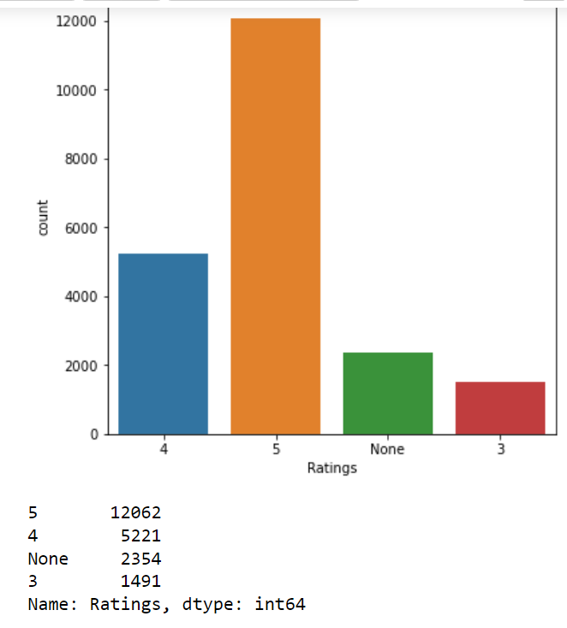
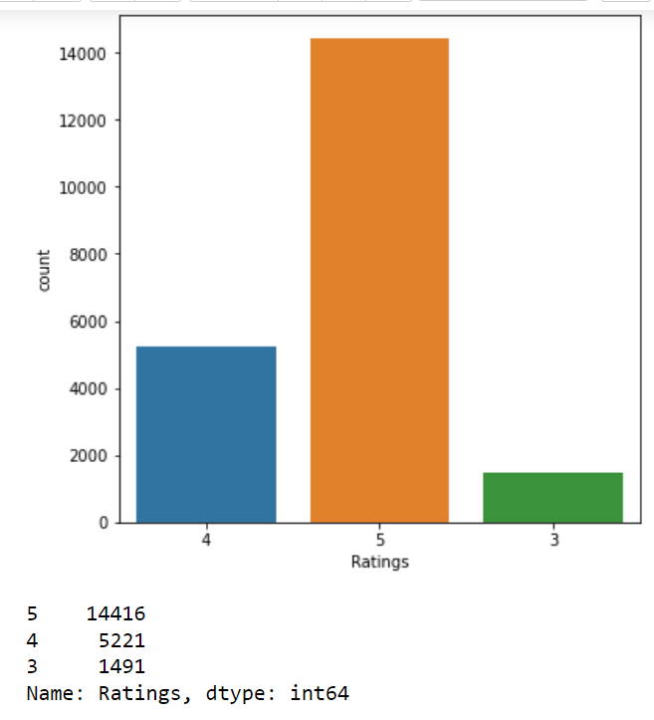
Ratings before and after removing ‘none’ value.

Slide 8
Steps and assumptions

Slide 9
We all buy the products through the e-commerce websites, the first thing we look about the product is review and ratings.
So it is the one of the major factor for buying a products.
If the product have good ratings and reviews, it will attracts the customer like us.
So the feedback of the products who buys it they are sharing their experience of the products.

Slide 10
Model dashboard
Here I used three different models.
Linear support vector machine, multinomial naïve bayes and random forest classifier.
Three models performed well, three of them have above 95% of accuracy.
To finalize the model, I compare the cross validation score with accuracy score of each models.
All models have same difference between them, I choose random forest as my final model.
And tuned with parameters and get best parameters.

Slide 11
conclusion

Slide 12
As I mentioned, review and rating of a product will attracts the customers like us.
Reviews and ratings are the experience of the customer or the people of the customer.
If we are plan to watch a movie, first of all we look for the review of the movie, before watching. If the movie gets positive review it will makes the collection in boxoffice.

